Slide 1
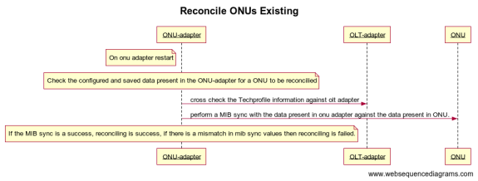
Reconcile ONU process in onu- adapter

Slide 2
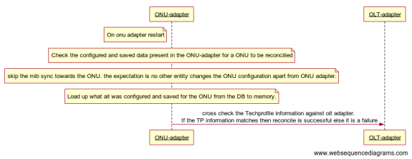
Reconcile ONU process in onu- adapter

Slide 3
Difference between existing and new flow
Existing
  ONU adapter, on a restart/upgrade has to go to all ONUs for a MIB sync which will spike of the resource consumption of ONU and OLT adapter in case of high scale.
  The existing MIB sync mechanism doesn’t try to recover, it just reports an error and marks the ONU as reconciling failed.
  New Flow
    The ONU adapter need to go to ONUs to check for MIB sync states, instead consider whatever is present and olt adapter as TechProfile and in the DB as the correct information assuming there is no external entity changing the ONU adapter configuration.
    Will reduce the resource spikes during reconciliation.
    If there is any mismatch in techprofile information from olt adapter and information present in onu adapter then onu adapter can consider the reconcile process as failed.

