Slide 1
VOLTHA Technology Profiles
June 2018
<number>

Slide 2
Modules
ONOS Applications
AAA, SADIS, vOLT
VOLTHA OfAgent
Meter Table and Specific Table Id Support
VOLTHA Core
Local_Handler, Logical_Device_Agent Update
Flow_Decomposer Update
VOLTHA Adapters
Meter → Downstream and Upstream Bandwidth Allocations and Service Profiles
Notes:
Try to create some flows related to edge cloud registration and subscriber provisioning
Tried to define tosca model definition

Slide 3

ONOS Applications

Slide 4
VOL-732
Currently SADIS caches Subscriber records defining Subscriber Tagging requirements, authentication data and other service flow information. The OF Flow Table ID used to reference a Technology Profile for a given Subscriber needs to be able to be added to the Subscriber Record and a Reference to an Upstream and Downstream OF Meter also supported.
Notes:
We can continue to work for this models and flows offline.

Slide 5
ONOS Applications
AAA > EAP packet processor - acts as a NAS or it can be an external NAS
SADIS > The configuration can be local or remote
Keeps the subscriber information(c-tag, s-tag, uniport) in cache
VOLT > Provisions the subscriber
Sends proper flow rules based on c-tag and s-tag
Creates events such as Subscriber_Registered, Subscriber_Unregistered
Notes:
01: Otherwise we have to move all existing XOS functionalities to ONAP and I think this is an architectural decision and it will bring to much effort.
Multicloud is responsible for cloud infrastructure where the vnf components are fully controlled by ONAP. At our case, we don't want to give full control of VNF to ONAP and want to cover abstraction of cord physical devices.
You may suggest to you PNF: if we try to use PNF onboarding for cord hardware components, physical devices will be under control of ONAP where we don't want to encapsulate cord under onap. Also we don't want to use PNF instantiation phases as well.
APPC is responsible VNF LCM of L4-L7 network. We cant use APPC because, LCM are done at Cord. Addition to that the actions, we made on subscriber provisioning, has consequence not only at L4-L7 but also L2 and L3 at R-Cord. Moreover APPC flows might affected too many due Edge Cloud modifications.​

Slide 6
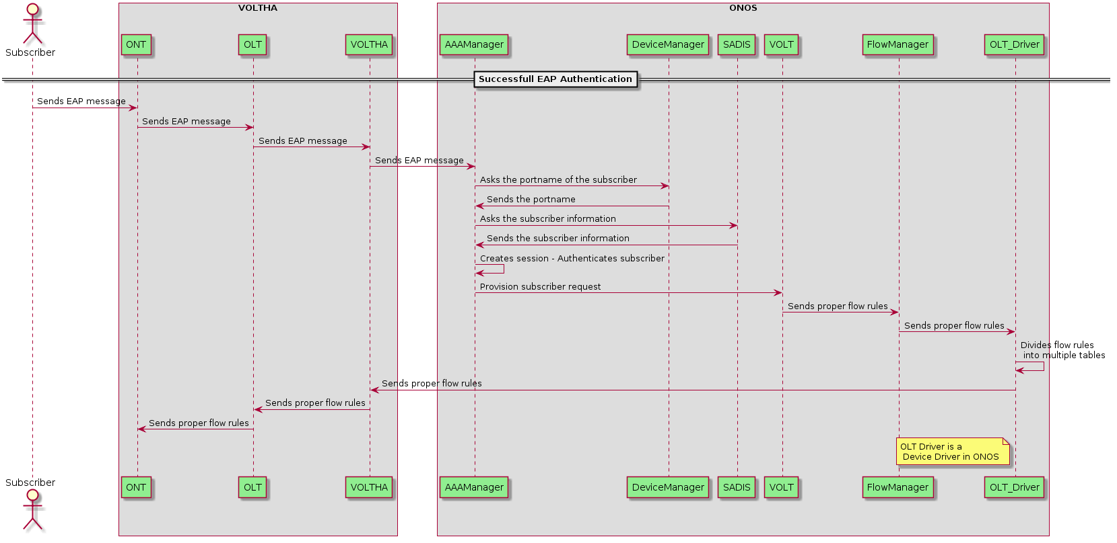
Current ONOS Application Flow
Notes:
In this picture ECC was depicted as an adaptor but now we foreseen that we think, it should be a new module named as Edge Cloud Controller.
Again it is architectural decision that we have to talk with ONAP TSC.

Slide 7
ONOS Application Changes
SADIS reads the subscriber information (c-tag, s-tag, uni-port, TP_ID, Upstream and Downstream meter bands) – it can be a name for meter bands on SADIS config and vOLT can read the details of meter bands from database or another configuration ?
{
"id":"uni-128",
"cTag":2,
"sTag":2,
"nasPortId":"uni-128",
"table-id":64,
"downstream-meter-bands":[
{
"meter-band-type":"No-Action",
"rate":"1Gb/s",
"burst":"384Kb/s"
}
],
"upstream-meter-bands":[
{
"meter-band-type":"No-Action",
"rate":"1Gb/s",
"burst":"384Kb/s"
},
{
"meter-band-type":"No-Action",
"rate":"100Mb/s",
"burst":"384Kb/s"
}
]
}
{
"id":"uni-128",
"cTag":2,
"sTag":2,
"nasPortId":"uni-128"
}

Slide 8
ONOS Application Changes (Cont.)
AAA gets the subscriber information (including TP_ID, Upstream and Downstream meter bands)
AAA calls provisionSubscriber(connectionPoint, vlan, TP_ID, upstream and downstream bandwidth)
VOLT sends meter-mod and after then proper flow rules that include meter definitions and proper flow table id (flow_table_id = technology profile_id)
- For each subscriber, there will be 2 meters
Flow Manager and OLT Driver in ONOS will update based on newly information
First Test Case: 4QueueHybridProfileMap1 with single meter bands

Slide 9
VOLTHA OF-AGENT

Slide 10
VOL-733
Need to support Error Checking for consistency – if Meter Reference made then need Meter to exist first before reference. → This can be related to VOLTHA CORE
If Flow Table ID does not resolve to a Technology Profile in KV Store generate an error → This can be related to VOLTHA CORE
OF Agent needs to pass through the Meter/Meter Band programming and the Flow Table ID used to reference the Technology Profile
The VOLTHA core needs to be able to receive meters from the OFAgent and store them in the appropriate logical device. A new northbound API needs to be added to the core to support this.
Notes:
We can continue to work for this models and flows offline.

Slide 11
VOLTHA OF-AGENT
Acts as an OpenFlow switch
Creates OpenFlow connection to ONOS
Handles and parses OpenFlow messages
Make calls to update flow and group tables
The calls are based on Protobuf & GRPC
Notes:
Class Definition of the AAI model schema should be generic.
Edge Cloud instead of Cord
Access Device instead of OLT and ONT Devices
AAI model schema file should store in the database as the following structure.
Cloud Infrastructure is already defined in the A&AI but this model definition is not suitable to define edge cloud infrastructure because there is no any attribute to define access devices in cloud infrastructure data model in A&AI.
After this definitions, rest apis and object definitions are created automatically
Siyah Nokta: Because current onap architecture does not support to use AAI model definitions as a library. All this models are auto-generated on its own model separately

Slide 12
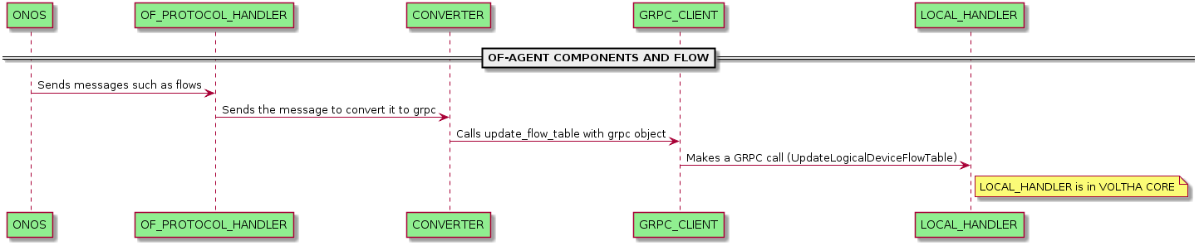
VOLTHA OF-AGENT COMPONENTS
Notes:
Class Definition of the AAI model schema should be generic.
Edge Cloud instead of Cord
Access Device instead of OLT and ONT Devices
AAI model schema file should store in the database as the following structure.
Cloud Infrastructure is already defined in the A&AI but this model definition is not suitable to define edge cloud infrastructure because there is no any attribute to define access devices in cloud infrastructure data model in A&AI.
After this definitions, rest apis and object definitions are created automatically
Siyah Nokta: Because current onap architecture does not support to use AAI model definitions as a library. All this models are auto-generated on its own model separately

Slide 13
VOLTHA OF-AGENT Changes(Cont)
of_protocol_handler
* Implement Necessary Functions
def handle_meter_mod_request(req)
def handle_meter_stats_request(req)
* Implement Optional Functions For Technology Profile
def handle_meter_config_request(req)
def handle_meter_features_request(req)
Notes:
Class Definition of the AAI model schema should be generic.
Edge Cloud instead of Cord
Access Device instead of OLT and ONT Devices
AAI model schema file should store in the database as the following structure.
Cloud Infrastructure is already defined in the A&AI but this model definition is not suitable to define edge cloud infrastructure because there is no any attribute to define access devices in cloud infrastructure data model in A&AI.
After this definitions, rest apis and object definitions are created automatically
Siyah Nokta: Because current onap architecture does not support to use AAI model definitions as a library. All this models are auto-generated on its own model separately

Slide 14
VOLTHA OF-AGENT Changes(Cont)
converter
* Add Meter Instruction
Update make_loxi_instruction(inst) to support Meter instruction
Update to_grpc_converters dictionary
Create loxi_meter_to_ofp_instruction() function
Notes:
Class Definition of the AAI model schema should be generic.
Edge Cloud instead of Cord
Access Device instead of OLT and ONT Devices
AAI model schema file should store in the database as the following structure.
Cloud Infrastructure is already defined in the A&AI but this model definition is not suitable to define edge cloud infrastructure because there is no any attribute to define access devices in cloud infrastructure data model in A&AI.
After this definitions, rest apis and object definitions are created automatically
Siyah Nokta: Because current onap architecture does not support to use AAI model definitions as a library. All this models are auto-generated on its own model separately

Slide 15
VOLTHA OF-AGENT Changes
Protobuf – GRPC
* openflow_13.proto (messages)
FlowMeterTableUpdate
FlowMeters
* voltha.proto (services)
For both Global and Local Service
Void UpdateLogicalDeviceFlowMeterTable(FlowMeterTableUpdate)
FlowMeters ListLogicalDeviceFlowMeters(ID)
Notes:
Class Definition of the AAI model schema should be generic.
Edge Cloud instead of Cord
Access Device instead of OLT and ONT Devices
AAI model schema file should store in the database as the following structure.
Cloud Infrastructure is already defined in the A&AI but this model definition is not suitable to define edge cloud infrastructure because there is no any attribute to define access devices in cloud infrastructure data model in A&AI.
After this definitions, rest apis and object definitions are created automatically
Siyah Nokta: Because current onap architecture does not support to use AAI model definitions as a library. All this models are auto-generated on its own model separately

Slide 16
VOLTHA OF-AGENT Changes(Cont)
grpc_client
* New Meter Functions
def update_meter_table(device_id, meter_mod)
Makes GRPC call using UpdateLogicalDeviceFlowMeterTable
def list_meters(device_id)
Makes GRPC call using ListLogicalDeviceFlowMeters
Notes:
Class Definition of the AAI model schema should be generic.
Edge Cloud instead of Cord
Access Device instead of OLT and ONT Devices
AAI model schema file should store in the database as the following structure.
Cloud Infrastructure is already defined in the A&AI but this model definition is not suitable to define edge cloud infrastructure because there is no any attribute to define access devices in cloud infrastructure data model in A&AI.
After this definitions, rest apis and object definitions are created automatically
Siyah Nokta: Because current onap architecture does not support to use AAI model definitions as a library. All this models are auto-generated on its own model separately

Slide 17
VOLTHA CORE

Slide 18
VOL-736
We will use Existing architecture of Flow Decomposer passing down to both OLT Adapter and ONU Adapter. The Technology Profile Flow Table ID (range 64-255) and Meter Programming OpenFlow Messages MUST be passed unmodified down to the OLT and ONU Adapters.
Notes:
We can continue to work for this models and flows offline.

Slide 19
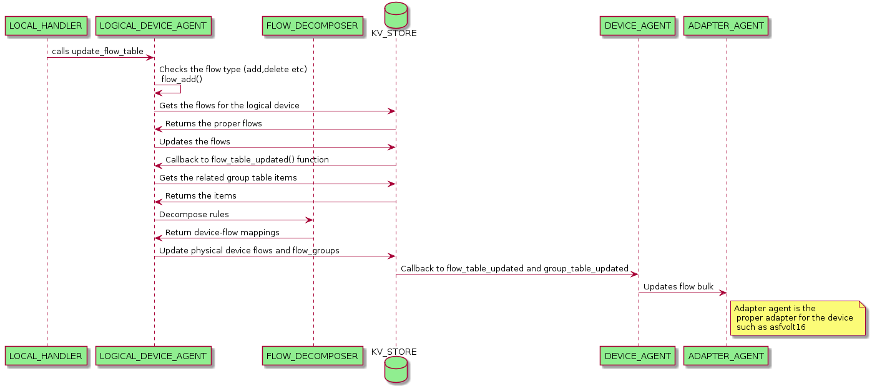
VOLTHA CORE FLOW (i.e. Flow Addition)
Notes:
We can continue to work for this models and flows offline.

Slide 20
VOLTHA CORE Changes
local_handler
* Gets the GRPC calls from OfAgent
* So… It has to implement newly added meter GRPC services:
def ListLogicalDeviceFlowMeters()
def UpdateLogicalDeviceFlowMeterTable()
global_handler (?) - no implementation for VOLTHA 2.0
* Gets the GRPC calls
* So… It has to implement newly added meter GRPC services:
def ListLogicalDeviceFlowMeters()
def UpdateLogicalDeviceFlowMeterTable()
Notes:
Class Definition of the AAI model schema should be generic.
Edge Cloud instead of Cord
Access Device instead of OLT and ONT Devices
AAI model schema file should store in the database as the following structure.
Cloud Infrastructure is already defined in the A&AI but this model definition is not suitable to define edge cloud infrastructure because there is no any attribute to define access devices in cloud infrastructure data model in A&AI.
After this definitions, rest apis and object definitions are created automatically
Siyah Nokta: Because current onap architecture does not support to use AAI model definitions as a library. All this models are auto-generated on its own model separately

Slide 21
VOLTHA CORE Changes (Cont)
logical_device_agent
* Define
meters_proxy to call KV store – can check meter existing
* Update
_flow_table_updated function – it will get meter items from KV store
* Create
update_flow_meter(meter_mod) function
meter_add(meter_mod)
meter_delete(meter_mod)
meter_modify(meter_mod)
Notes:
Class Definition of the AAI model schema should be generic.
Edge Cloud instead of Cord
Access Device instead of OLT and ONT Devices
AAI model schema file should store in the database as the following structure.
Cloud Infrastructure is already defined in the A&AI but this model definition is not suitable to define edge cloud infrastructure because there is no any attribute to define access devices in cloud infrastructure data model in A&AI.
After this definitions, rest apis and object definitions are created automatically
Siyah Nokta: Because current onap architecture does not support to use AAI model definitions as a library. All this models are auto-generated on its own model separately

Slide 22
VOLTHA CORE Changes (Cont)
flow_decomposer
* Update
decompose_rules(flows, groups, meters)
decompose_flow(flow, group_map, meter_map)
mk_simple_flow_mod(…, meter) – it will add the meter to instructions
Notes:
Class Definition of the AAI model schema should be generic.
Edge Cloud instead of Cord
Access Device instead of OLT and ONT Devices
AAI model schema file should store in the database as the following structure.
Cloud Infrastructure is already defined in the A&AI but this model definition is not suitable to define edge cloud infrastructure because there is no any attribute to define access devices in cloud infrastructure data model in A&AI.
After this definitions, rest apis and object definitions are created automatically
Siyah Nokta: Because current onap architecture does not support to use AAI model definitions as a library. All this models are auto-generated on its own model separately

Slide 23
VOLTHA ADAPTERS

Slide 24
VOL-737
When the OpenOLT Adapter is passed the OpenFlow programming information it will look for a Technology Profile Reference by examining the Flow Table ID index. An Index in the range 64-255 will indicate it is a Reference to a Technology Profile
The Meter(s) referenced in the OpenFlow messages will be used to generate the Downstream Bandwidth Profile for the Service and also the Upstream DBA Bandwidth Parameters.
When the OpenOLT Adapter retrieves both the OpenFlow Programming Messages and a specific Technology Profile it will use the Technology Profile and Flow Data to create a Service Specific Profile Instance. (T-CONT, GEM Port, GEM Queues)
This is related to VOL-735 and VOL-738. To do this task, firstly the community must decide the approach for VOL-735 and the difference between VOL-737 and VOL-738 must be found. The descriptions of VOL-737 and VOL-738 are same!
Notes:
We can continue to work for this models and flows offline.

Slide 25
Adapter Changes
Broadcom ONU Adapter:
update_flows_bulk(device, flows, groups, meters)
update_flow_table(device,flows,meters)
OpenOlt Device:
update_flow_table(flows, meters)
OpenOlt Adapter:
update_flows_bulk(device, flows, groups, meters) - ?
There is no implementation for GEM, T-CONT, Interfaces and Alarms
Notes:
We can continue to work for this models and flows offline.

Slide 26
THANK YOU

